Slide 1
Our new digital life in Europe
A short guide for Euro-junta inhabitants
Kim De Vos @avbpodcast
version 150724

Slide 2
1 ) a puzzle of EU regulations
( secrecy, protection, compartments of control )
2 ) make them work for it
( a small guide, food for thought )

Slide 3
1
The puzzle pieces of EU-regulation

Slide 4
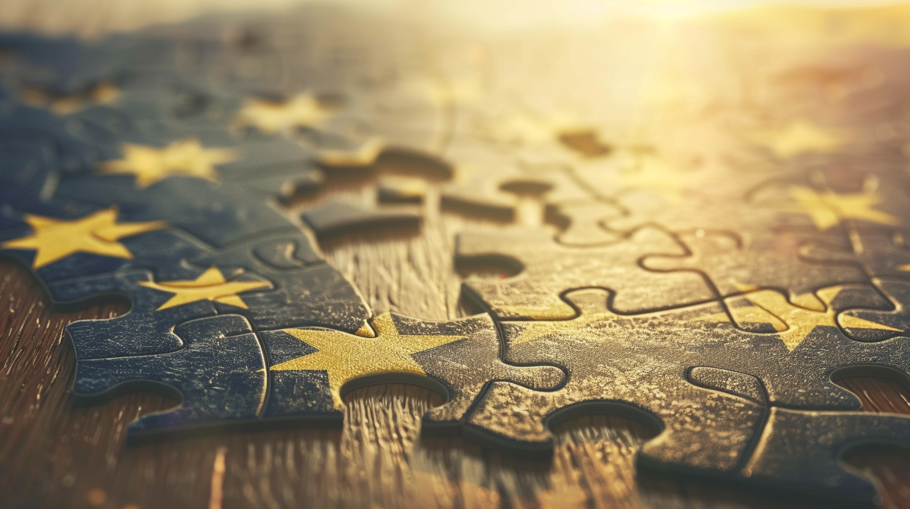
One by one // the puzzle
The EU regulatory tools and regulations Brought online and into law one-by-one, and the people get nudged into them.
Regulators… are going to regulate.
That’s their raison d’ être

Slide 5
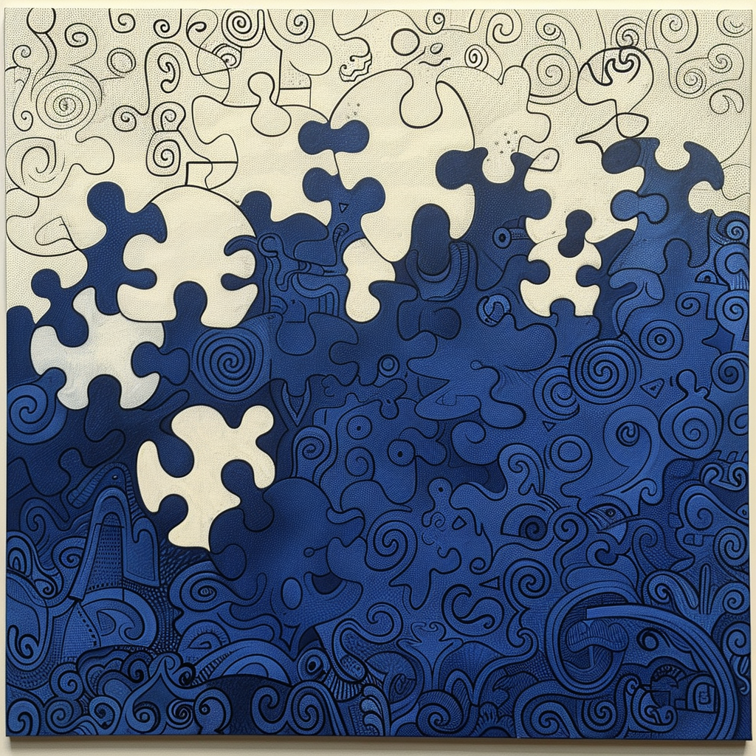
Banking secrecy
European Union Savings Directive (EUSD): Implemented in 2005
Common Reporting Standard (CRS): Developed by the OECD in 2014 (implemented by Belgium and most EU countries in 2017) for exchange of financial account information to combat tax evasion
Money Laundering Directive (phase 1 tot 6)
1990 -> 2021 (Customer Due Diligence (CDD), Enhance Transaction Monitoring: AI and ML algorithms
In the end: a 2-Tier “Gosbank” system.
Banking

Slide 6
Info / Communication / DSA 1/2
General Data Protection Regulation - 2018 (GDPR)
NIS Directive (2016) - security requirements for operators of essential services and digital service providers across the EU.
Digital Services Act (DSA) 2020
Digital Markets Act (DMA) 2020
The DSA introduces rules to address illegal content online, while the DMA targets large online platforms with significant market power, imposing obligations to ensure fair competition and protect consumer rights.
ePR ePrivacy Regulation (stronger cookie + data tracking regulation - 2024)
NEXT piece of the puzzle will be DNS regulation (“internet infrastructure”)
Communication

Slide 7
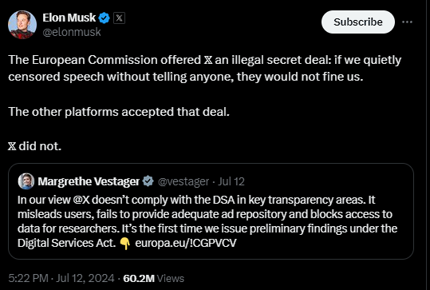
Info / Communication / DSA 2/2
Communication

Slide 8
Metadata / compartmentalization
Meta data is kept "hashed" or anonymized in databanks all over Europe.
These are each on itself rather harmless at first glance.
The compartements of each company, each database and every single entity is however not possible to use for gain on a lower level (e.g; selling a 1€ coffee to someone with a higher budget at 15€ while selling the same coffee in the same store to someone with a lower budget at 2€ for example).
Examples…
METADATA SET1

Slide 9
Metadata / compartmentalization
Businesses can't set their price individually per customer / good.
A government however does this all the time by collecting the anonymous data and combining it, taking it out of the compartments.
From our example, this person is identifiable by their name, social security status, income, eco-footprint, medical history, and even details like where they parked and what they had for lunch—all supposedly anonymous. However, when these disparate data sets are combined, they are far from anonymous.
Only these institutions (gov.) possess the ability to piece these puzzle pieces together.
METADATA SET2
METADATA SET3
METADATA SET4

Slide 10
EiDAS 2.0
eIDAS 2.0, ( European Digital Identity Regulation)
is an updated version of the original eIDAS (electronic IDentification, Authentication and trust Services) regulation adopted by the European Union in 2014.
The main objectives of eIDAS 2.0 are to:
Expand the number of services and trust services covered by the regulation, such as electronic certificates for authentication
Make implementing electronic transactions more consistent, particularly via the introduction of the European Digital Identity (EUDI) Wallet
Incorporate safer and more convenient electronic transactions across a wider range of daily activities, such as applying for a job, booking a flight,
eIDAS 2.0 was adopted in February 2024 and ratified by the European Council in March 2024
IDENTIY EXPANSION
E-WALLETS
CBDC links

Slide 11
CSAM (already implemented) 2011 and fine tuned onwards
Scanning images …
happens on the platforms itself (no matter what you encrypt, no matter what dns you use, they participating companies will scan the “fingerprint” (hash) of a set of data (video, image, pdf …)
https://www.europarl.europa.eu/RegData/etudes/STUD/2023/740248/EPRS_STU(2023)740248_EN.pdf
A known image of child abuse for example, will have a specific fingerprint, and if that fingerprint is posted on facebook or instragram, the detection is almost instantaneous.
PhotoDNA (MSfT) https://www.microsoft.com/en-us/photodna

Slide 12
Chat control proposal
The “chat control” rule, will expand that CSAM fingerprinting on to person to person communication, or private groups on instant messaging apps.
Seen on it’s own, a lot of people will even like this system.
That’s the piece of the puzzle: implement a weapon for something good, to expand the targets later on to other stuff.
It’s always expanded later on, when tools are in place.

Slide 13
NIS2 DNS control (the next frontier)
EU NIS-2 Proposal and DNS Security
The EU NIS-2 proposal aims to enhance “cybersecurity” across the European Union by addressing various aspects of network and information systems. Specifically, it focuses on the Domain Name System (DNS)
It addresses: availability (own EU approved DNS servers) DNS Operators, DNS Fragmentation (Chinese firewall and top-level DNS incompatibility for example)
DNSSEC: (positive on itself! ) The proposal places significant emphasis on ensuring the authenticity and integrity of DNS information.
NIS-2 Directive by October 17, 2024,
Will be applied from October 18, 2024 onwards (no discussion or debate seen!!!)

Slide 14
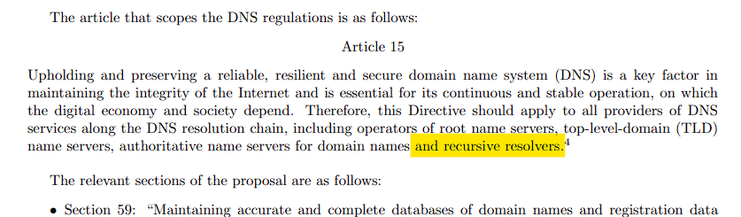
NIS2 DNS control (the next frontier)

Slide 15
EUCS
"European Cybersecurity Certification Scheme for Cloud Services,"
The EUCS rule standardizes cloud security in the EU.
- favoring large providers
- higher costs
- more complexity
- national sovereignty issues
- difficult for implementation and enforcement

Slide 16
THE PUZZLE:
METADATA SETS
CBDC links
DNS control
METADATA SETS
Banking
METADATA SETS
E-WALLETS
EUCS
15 min. city
CSAM
METADATA SETS
IDENTIY EXPANSION
Communication

Slide 17

All these “tools” to “protect us”...
Will form a “Digital dragnet” over time
CBDC
DNS
CSAM
METADATA SETS
Banking
E-WALLETS
E-WALLETS
EUCS
ePR
Communication
More METADATA
METADATA SETS
IDENTIY EXPANSION
Telecom
15 minute cities
or : “a democratic, social, safe place to live in prosperity” :)

Slide 18
The EU must use its regulations to maintain or expand control, as it cannot gain or lose new members or users. Everything is imposed to sustain its own system, much like old nation-states, empires, or the USSR.
The rules and the method of “consensus” nudging/imposing must be enforced from the top down; it is not sold in an open market of ideas or ideologies.
With proof-of-stake (fiat) at its core.

Slide 19
It is an axiom of loss
An axiom of loss, where citizens strive to exist, continuously trying to limit their damage, overcome inflation and save their soul/identity.
It is a sink or swim system, where you are even taxed on moving water.

Slide 20
In contrast:
Bitcoin is growing and sometimes requires changes in the consensus rules. Bitcoin imposes nothing from the top down. Decisions are made through votes by full nodes, with a secured network via miners and their computing power. With proof of work at its core.
It is an axiom of value.
Where you pump, drink, and move water, with the luxury of even being able and allowed to share water, if necessary.

Slide 21
2
Make them do the work!

Slide 22

We know corporations and ad-network / clusters are tracking us…
Discuss a new gaming mouse you’re interested in, and you’ll see ads for it everywhere for weeks, even after you've made the purchase.
Companies are eager to sell, and they need data to target potential customers more efficiently.
Customers have a choice to buy or not to buy (or to block the ads/companies)

Slide 23
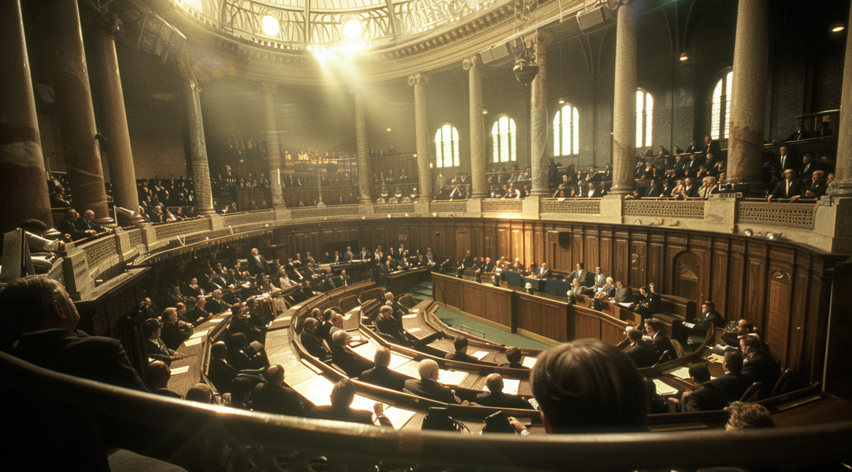
We know governments are tracking us…
They aim to maintain control, protect their position, and avoid any potential issues.
They’re not selling,the customers are
Citizens without much of a choice.
Example: try to avoid “itsme” and you’ll see how difficult it gets

Slide 24
Government surveillance and data mining
aren't going away anytime soon.
As bitcoiners, we always route around problems. ADAPT
As citizens we might live in the fiat-flytrap for most of our lives, but online we can try to make it harder to track/control us, at least to do it for free.
That’s the goal of this presentation:
let them do some proof-of-work for once
(the cost will be noticed)

Slide 25
The OSI-model
Everyone plays by the same technical ground rules
(for now) let’s use that

Slide 26
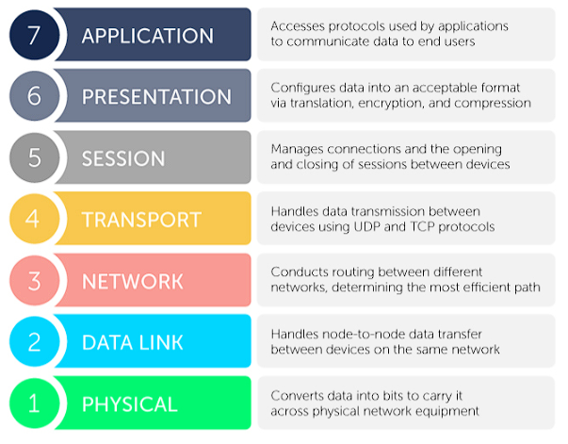
The OSI-model
A very short guide

Slide 27
Protect your basics
Make them work for their data-mining

Slide 28
DNS : the low-hanging fruit
DNS is the most easy, most used way to track behavior, a person’s habits, hits, visits, it’s clear-text copy-paste right into the databases.

Slide 29
Data mining on DNS queries is extremely simple:
90% of the people
use their internet connection "as is"
The DHCP servers of the ISP gives you their own DNS server for replying to DNS queries
All your connected devices follow that same scheme.
Some ISP routers don’t even allow to set other dns servers anymore. ‘Why would anyone want that?’

Slide 30
DoH, DoT , DnsCrypt
Solutions are :
DoH
encapsulation the clear text DNS requests into HTTPS over port 443 (encrypted like your bank app)
DoT Encapsulation DNS queries to TLS (Transport Layer Security )
Encrypted Client Hello (ECH) (even the handshake setup over TLS is encrypted)
DnsCrypt securing more pieces of the paths with your own DNScrypt server
(pi-hole and node runner users will probably know this).
Problem: DNS works fine, because the other side just needs to respond with an IP address,.... Not decrypt anything.
DNS over HTTPS works fine, unless the other side doesn’t understand the encryption.
(AES, RSA, etc…)

Slide 31
The OSI-model
A very short guide for Euro-junta inhabitants
Moving DNS queries down in the OSI model:
DNS : application layer
DoH : application/pres layer
DoT : app to transport layer

Slide 32
What you can do : specific examples
https://dns.sb/ - no logging secure DNS over https, tls and “clear” and DNSSEC (validation and tamper proof)
https://dnslow.me/ (+ filtering)
https://www.opennic.org/
https://opennameserver.org/
https://dns-ga.de/server-info.html (light filtering on malware)
https://blog.uncensoreddns.org/
TIP: you can also use these on UNgoogled-chromium
https://ungoogled-software.github.io/ungoogled-chromium-binaries/

Slide 33
What can I do : specific examples
Why not use 8.8.8.8 (google) or 1.1.1.1 (cloudflare) ?
You’ll donate more data, to your local ISP,
on top of that, to google and cloudflare.
If you don’t care about that, that’s fine as well.
It remedies nothing from a privacy perspective. It only speeds up your queries compared to the slow ISP dns servers.
You shouldn’t use any of these!

Slide 34
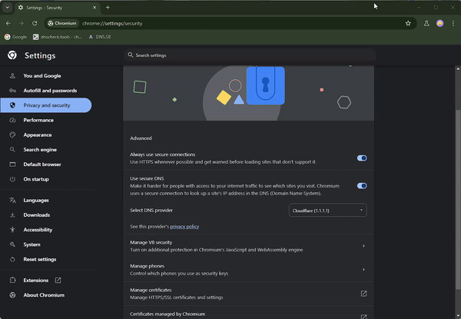

Slide 35
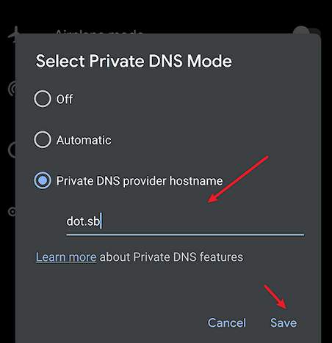
What can I do : specific examples
On Android :
set “private DNS” with
The TLS (DoT) link

Slide 36
How to test your setup?
https://dnscheck.tools
https://cmdns.dev.dns-oarc.net/
https://www.dnsleaktest.com/
https://www.doileak.com/classic.html

Slide 37
Some more info:
Trusted Recursive Resolver
https://wiki.mozilla.org/Trusted_Recursive_Resolver
Encrypted Client Hello (ECH)
https://blog.cloudflare.com/announcing-encrypted-client-hello
DNS Queries over HTTPS (DoH)
https://datatracker.ietf.org/doc/html/rfc8484

Slide 38
Instant messaging apps… diaspora of choice
ssh chat on linux, Wire, wickr, meshed network apps (download the apk), simple-x, 0xchat (nostr), getsession
All virus-like system (we all use) like Whatapp, Telegram , google message, apple messenger, FB messenger…
14 eyes are watching you

Slide 39
Instant messaging apps…
GetSession , Briar, Matrix protocol, Simple-X chat, Nostr, 0xChat … old skool SSH chat (Terminus) – Problem: adoption (101 flavors)
Current most used: Whatsapp, FB msg, Messenger (apple) and Telegram
MESHED (useful in shit-hit-the-fan situations / protests )
https://bridgefy.me/ (we need something like this for Nostr based contacts by the way:)
https://briarproject.org (Censorship-resistant peer-to-peer messaging)

Slide 40
Meta-data on the upper layer : there is simply no escape
Timestamps, addresses, actions, hits, MAC addresses…
Anonymized user fingerprints connected to action hits (restaurant visits, payments, concert tickets, parking space, rented bikes, even your toilet visits at an airport)

Slide 41
VPN as a next level step
Why DNS is the most easy, most used way to track behavior, taste and mine data

Slide 42
Encrypt AES256 to the cloud
Put sensitive, personal data (or everything!) in the cloud after encrypting it yourself with your own extra passphrase:
https://www.aescrypt.com/download/

Slide 43
Tech solutions are not all there is
“You can’t fix the money, without fixing your own world”
Try to build a local presence, network and “meshed” economy with skills and proof-of-work.

Slide 44
FIX your world / Building a Meshtadel / Citadel :
F*ck TV shows, Netflix addiction, garbage celeb-focused “news” and local FiatWorld discussions (we’re long past that).
Get resources (material, land, …)
Get hard money (gold, bitcoin, …)
Get and use skills (cooking, repairing, growing food,...)
Communicate private/encrypted (encrypt, meshed, private networks…)
Embrace and respect the Person to Person , community based life, without parasitic fiat loss.
Think like a bitcoiner, work like a slave, escape the axiome of loss

Slide 45
Building a Meshtadel / Citadel
Self-manage, federated if necessary
Pay each other in hard money (guess what?)
Own stuff / Grow stuff / Know stuff
Learn to love and value actions, people and small wins. (your people are your wealth)
Get to know real people, not algorithms and fake images / mirages of people that don’t exist.

Slide 46
Building a Meshtadel / Citadel
Build a network for communication / payments :
Examples: https://www.nobsbitcoin.com/introducing-nutband/ en
https://reticulum.network/
Why not build a Belgian/Dutch Meshtadel?

Slide 47
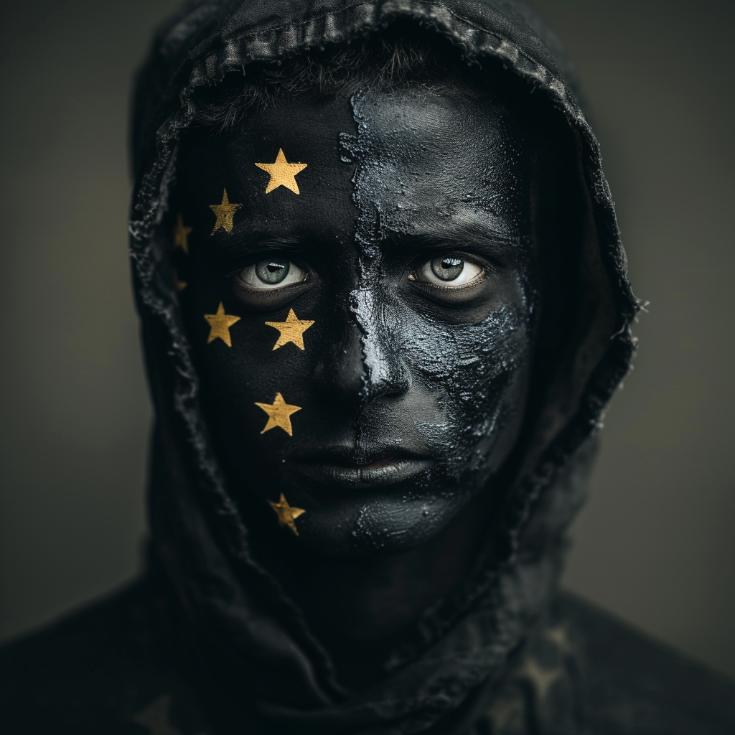

Future Europe
One version of your persona will be “upper layer” :
OK, happy and have a full star rating watching TV
Another version of you (the real you) will use bitcoin, VPNs, encrypting everything,
living in a (virtual)citadel
and still has a soul

Slide 48
Info and more links / reading material :
https://deadeyes.substack.com/p/eidas-de-great-eu-firewall-is-hier
https://digital-strategy.ec.europa.eu/en/policies/eidas-regulation
https://tuta.com/blog/fourteen-eyes-countries/
https://en.wikipedia.org/wiki/Zhima_Credit
https://www.euractiv.com/section/cybersecurity/news/defence-industry-wants-data-localisation-and-contractual-guarantees-in-eu-cloud-scheme/
https://deadeyes.substack.com/p/de-15-minuten-stad-district-9-antwerpen
https://archive.ph/7ZaFr EU Data Protection law

Slide 49
THANK YOU
reactie@allesvoorbitcoin.be

Slide 50

value 4 value? tipjar
Lightning
Other options: https://allesvoorbitcoin.be/donate
mr21@walletofsatoshi.com

